Slide 1
Presentation skills
Definition
Presentation skills can be defined as the abilities that people use to deliver information to different kinds of audiences in an effective and engaging manner.
Presentation skills involve organizing your time, using body language, choosing the proper presentation material, answering event attendees’ questions, and providing audience participation.

Slide 2
Good Presentation Skills: List with 15 Examples
Visual Communication
Interpersonal Communication
Verbal Communication
Humor
Storytelling
Attracting the audience
Keeping things simple
Using body language
Managing emotions
Self-awareness
Leadership
Focus on the audience
Active listening
Time organization
Doing research

Slide 3
Types of presentation
There are six types of presentation. First three are most common types than other three.
Providing information
Teaching a skill
Reporting progress
Selling a product or service
Making a decision
Solving a problem

Slide 4
Providing information
Informative presentations are the most common type. It’s an educational, to-the-point presentation that aims to provide new information or updates to the audience. For instance, it could be public consultation meetings about an upcoming project in the company.
The main goal here is to share information instead of entertaining or inspiring the audience. Informative presentations often include a few educational slides on a slide sorter with short and on-point information. However, you can add presentation notes in order to help your audience better understand the topic and generate questions.

Slide 5
Teaching a skill
Teaching new skills during public meetings is especially frequent in companies. In this case, as well, a presenter is sharing information with the team. However, the purpose isn’t only to share information but to instruct the audience on a particular topic.
The audience is attending the presentation in order to learn new skills and have a better understanding of the topic. Teaching new skills can take the form of training, workshops, or webinars.
On each occasion, the presenter offers specific instructions to help the audience use the new information in practice. Using techniques such as mind maps could be useful in the process of teaching new skills.

Slide 6
Reporting progress
Reporting progress has a bit different structure than standard presentation structures. Each team leader or company leader wants to know how their team is working. Therefore, the practice of scheduling presentations about the team’s progress is very common in the business industry.
Of course, the leader won’t assess the individual strengths and weaknesses of team members, but they might point out important achievements or overall drawbacks. So, if you want to report the progress of a new campaign or project, don’t forget to keep the outcome in mind and use as much informative visual information as possible.
Leaving time for questions is also important to make sure everyone understands the company’s goals.

Slide 7
Selling a Product or Service
A briefing like this might include a recap of the product or service, next steps and action items, or a discussion of needs and improvements before the product is ready to sell.

Slide 8
Making a Decision
It’s time for the annual holiday party and ideas are being tossed around the office. When giving your input on the location, make sure to share the must-haves and nice-to-haves for the event. When it’s time for the final decision, you can see how your idea stacks up to the other options

Slide 9
Solving a problem
This could be in a panel setting or other meeting where the problem is identified, the facts of the problem are presented and a list of causes is generated. From here, you lay out the ideal outcome, present solutions and discuss your recommendation.

Slide 10
Why presentation skills training is important
Presentation skills’ training is important to:
Develop proper structure of presentation
cover nervousness during presentation
Deliver presentation effectively
Learn what not to do during presentation
Design and use effective visual aids

Slide 11
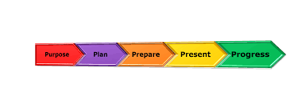
5 P’S Model of presentation

Slide 12
1. Purpose
Identify the Purpose of your presentation. You are, in effect, setting yourself a goal and outcome.

Slide 13
2. planning
Firstly, remember that famous quote “Failing to plan is planning to fail”!
Brainstorming and outlines
Write a draft
Plan visuual aids as ppt
How, What, When, Where, Who and Why.

Slide 14
Preparation
Split your presentation into a Beginning, Middle and End. Some people find it useful to write up a full “verbiage” or script for their presentation. Others like to write out “cue cards” with select words on. Cue cards are particularly useful to have with you when you present as they will keep you on track.

Slide 15
Presentation
You’re ready to Present!
Align Words, Tone and Body Language
Use Props and Visual Aids
Q/ answer session

Slide 16
Progress
Every situation is an opportunity to progress and learn. Use progressive feedback models to ensure the next time you present it is even better than this time!

Slide 17
Presentation Styles and Tips
Presentations can take many forms, that there is no universal perfect way to present. Pick out a style what is best for you, your audience, and your message.
Styles of Presenting
Visual Style
Often uses slides, props, or images to complement
Easy to prepare and present
Free Form Style
Has 2-3 key messages and focuses on them
Uses stories and humor
Little structure to the presentation

Slide 18
Continue ….
Instructor Style
Used for complex teachings
Information is presented in a logical order, building up to the key concept
Incorporates metaphors and figures to help audience understand
Coach Style
Often used by motivational speakers
Engages thoroughly with audience
Useful when you are passionate about a topic and what that interest to be past on

Slide 19
Continue….
Storytelling Style
Message is presented by telling a story
Uses emotions to connect to audience
Connector Style
Comfortable on stage and engaging the audience
Has some structure and organization(Recto, 2016)
Many of these styles can be combined to make your program/presentation your own!

Slide 20
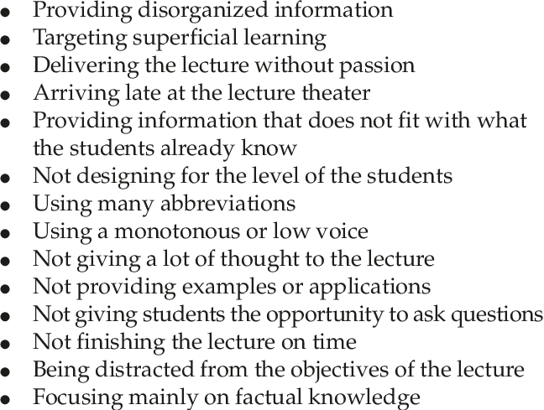
Common mistakes in presentation

